Slide 1


Presented By:
U.Likitha (S7524)

Slide 2

From Data to Insights:
A Step-by-Step Process
Introdution to Project
Dataset Understanding
Analyzing data
Report Presentation
Insights and Suggestions

Slide 3
Project Overview:
This project explores coffee quality using a dataset from the Coffee Quality Institute (CQI). Our goal is to analyze how different factors such as sensory attributes (aroma, flavor, acidity, etc.),processing methods,orign and defects affect coffee quality, using Power BI for data visualization and insights.

Slide 4
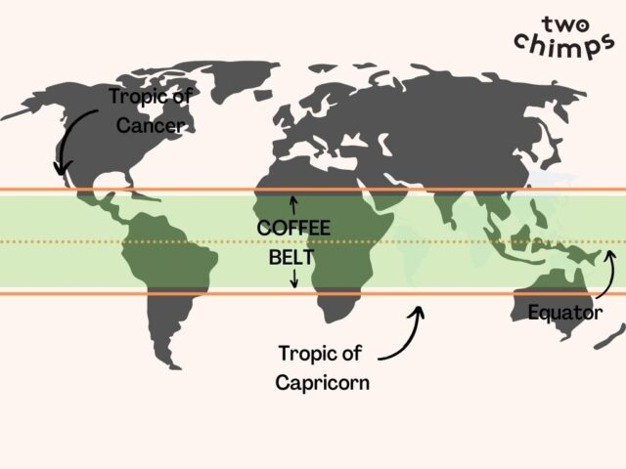
Climate & Altitude: Coffee thrives in tropical climates, typically grown at altitudes between 100 to 2,000 meters, with ideal temperatures between 15°C to 24°C.
Latitude Range: 23.5°N and 23.5°S, known as the Coffee Belt.
Processing Methods (Cost-Efficient): Natural Process (cheapest, sun-dried, fruity) or Pulped Honey Process (low-cost, balanced sweetness).
Processing Methods (Best Quality): Washed Process (clean, bright flavors) or the Double Anaerobic Process (complex, intense flavors)
Coffee Varieties (Cost and Quality): Castilla, Typica, and Caturra offer balanced flavors and moderate costs, while Gesha (Geisha) known for its exceptional complexity and floral notes.
Harvest and Grading time: The difference can be around 3-4 months for better coffee quality.

Slide 5
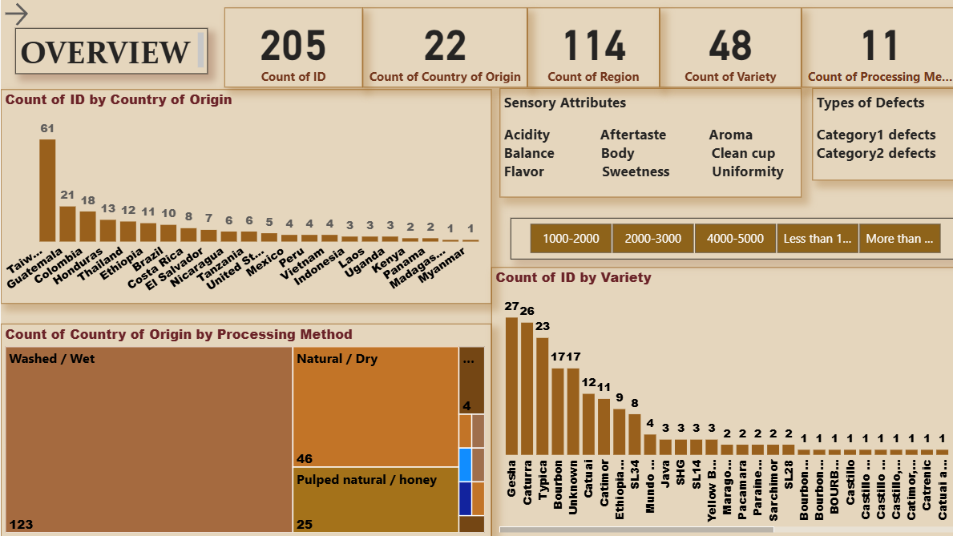

Slide 6
Key Determinants of Coffee Quality:
What are the key sensory attributes (aroma, flavor, aftertaste, etc.) contributing to coffee quality?
Processing Methods and Origin Regions:
Is there a correlation between coffee quality and different processing methods or regions of origin?
Defect Impact on Quality:
Can we identify trends in defect occurrence and their effect on overall coffee quality?
Interaction of Variables:
How do the sensory attributes interact to influence Total Cup Points, an overall measure of quality?

Slide 7


Microsoft Power BI

Slide 8
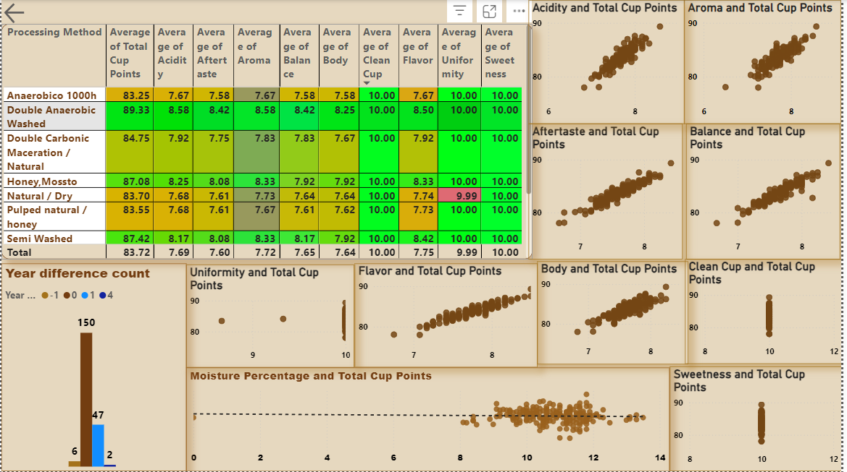

Slide 9
Insights and Suggestions:
Sensory Attributes: We should aim to maintain all sensory attribute values above 8.0 to enhance the count of good quality coffee.
Production and Quality: While Taiwan ranks first in coffee production, Colombia achieves the highest total cup points, showcasing the importance of variety in quality. However, due to the high cost of the double anaerobic process, most countries opt for the washed and natural processing methods. It's crucial to pay attention to the choice of coffee varieties.
Defects Categories: In the defects categories, Category Two is showing more negative results compared to Category One.
Other key variables: I considered include altitude, moisture, and the year of harvest and grading. Increased moisture content negatively impacts total cup points, and a difference of more than one year between the harvest and grading years also affects coffee quality..

Slide 10


